Slide 1
Monthly Interest Rate Forecasting
& Financial Statement Analysis
Osama Ahmed, Vivian Zhang, Ching-Lung Hsu, Kundan Dasgupta

Slide 2
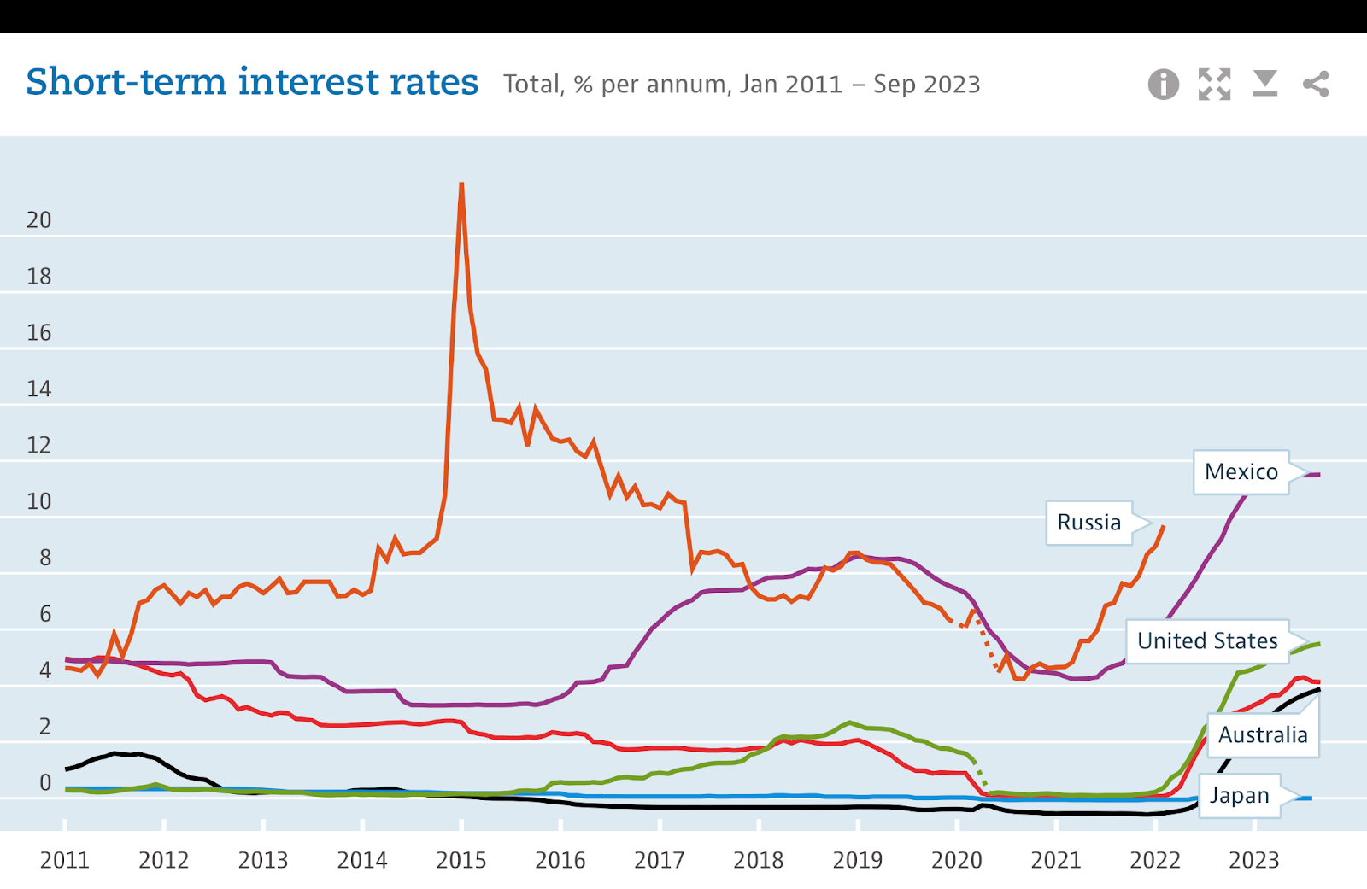
Technical Project
Data Sources:
OECD Interest Rate Data
US Bureau of Economic Analysis Macroeconomic Data
US Daily Treasury Rates Data
Notes:
How to have access to the data (Nvidia) we have interest?

Slide 3
Data Collection & Pre-processing
Two Data Source: The 1st data is comprised of Monthly interest rates from the OECD alongside other macroeconomic variables. The 2nd data is obtained from daily treasury rates data from the US Treasury Daily Treasury Yield.
Macroeconomic Variables: Personal Income, Industrial Production, Money Supply - Deposit, and
Money Supply - Currency/Demand Deposit/Traveller Check.
Handling Missing Values: Dropping columns with NaN values, ensuring the integrity of the dataset.
Sorting and Indexing: The data was sorted chronologically based on the date, and the date was set as the index for time-series analysis.
Statistical Testing: The Augmented Dickey-Fuller (ADF) test was employed to assess the stationarity of the time series data. Differencing was applied to achieve stationarity.
Differencing Technique: Taking the difference between consecutive observations in the time series. This can help remove trends and seasonality in the data.

Slide 4
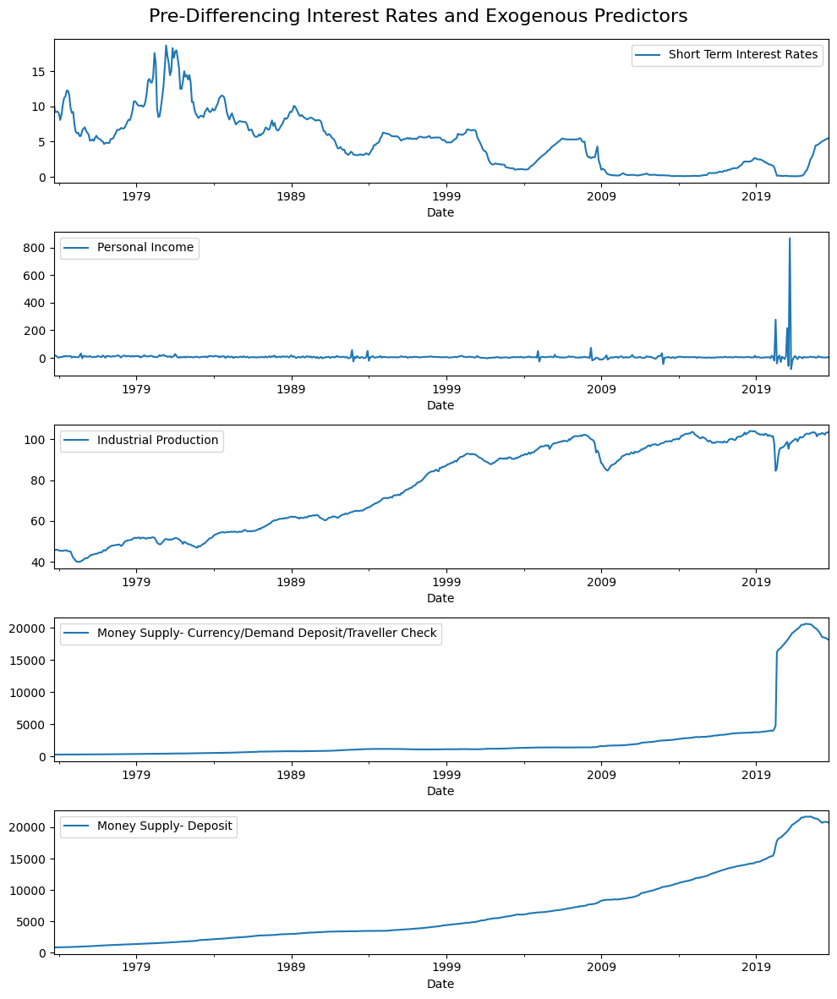
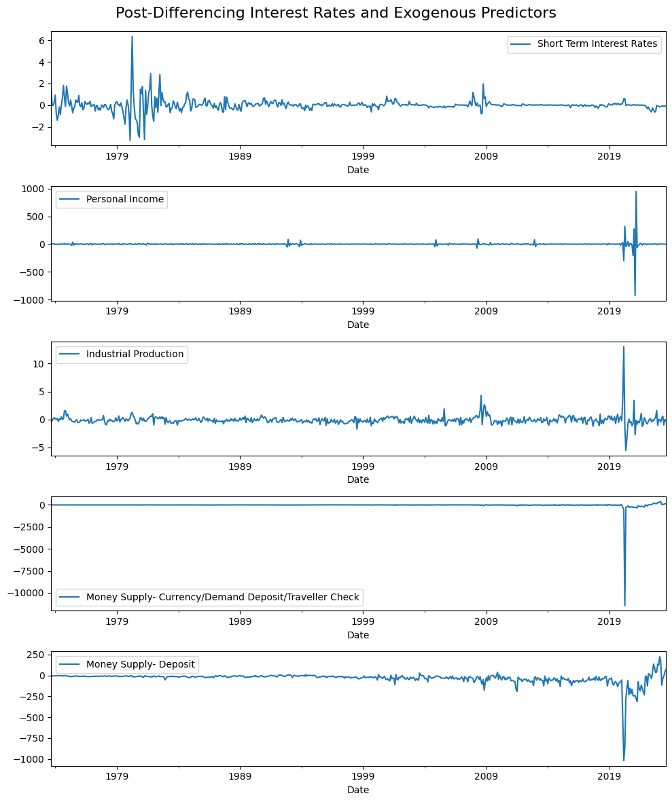
Monthly Interest Rates (The 1st Dataset)

Slide 5
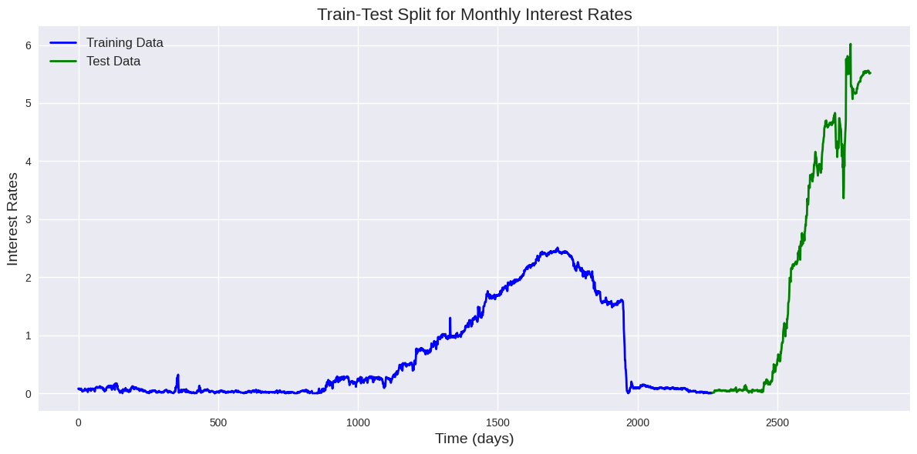
Daily Treasury Rates (The 2nd Dataset)

Slide 6
Model Selections and Training
Model | Library Used | Architecture | Training | Dataset
AutoRegressive Integrated Moving Average (ARIMA) | Statsmodels | Grid search was performed to find optimal parameters (p, d, q) for the ARIMA model. | Exogenous economic indicators were included to enhance predictability. | 1st
Multilayer Perceptron (MLP) | Scikit Learn | A basic MLP neural network with three hidden layers of 100 neurons each. | Trained on stacked batches of historical interest rate data. | 2nd
Convolutional Neural Network (CNN) | TensorFlow and Keras | A 1D CNN model designed with convolutional and pooling layers to capture local patterns in the time series data. | Trained on reshaped input data, considering the sequential nature of the time series. | 2nd
Long Short-Term Memory (LSTM) | TensorFlow and Keras | An LSTM model with two layers to capture long-term dependencies in the time series. | Trained on reshaped input data. | 2nd

Slide 7
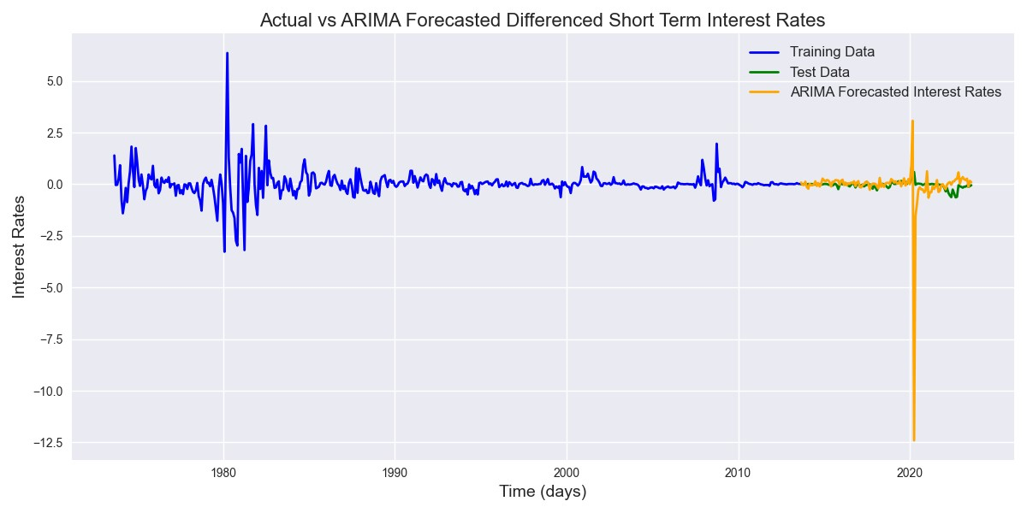
Results

Slide 8
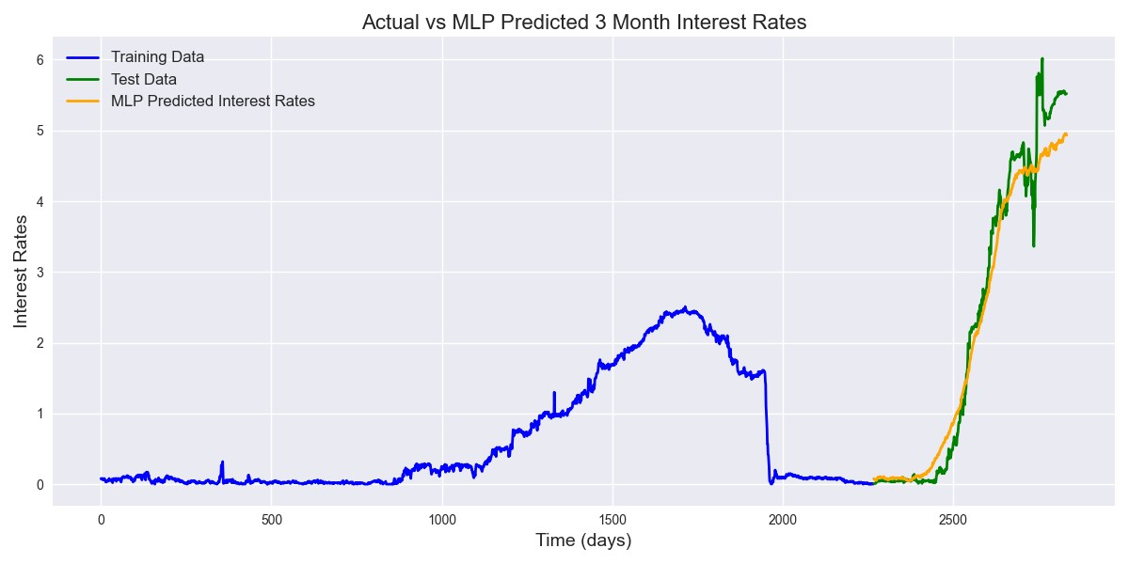
Results

Slide 9
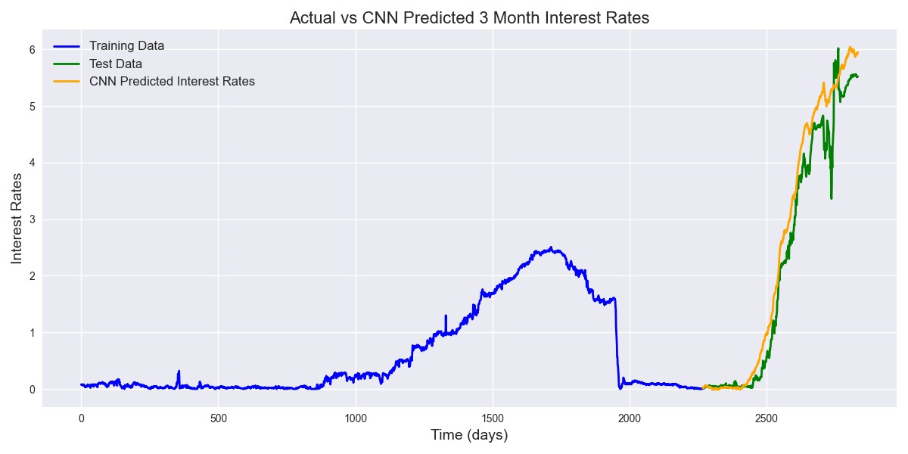
Results

Slide 10
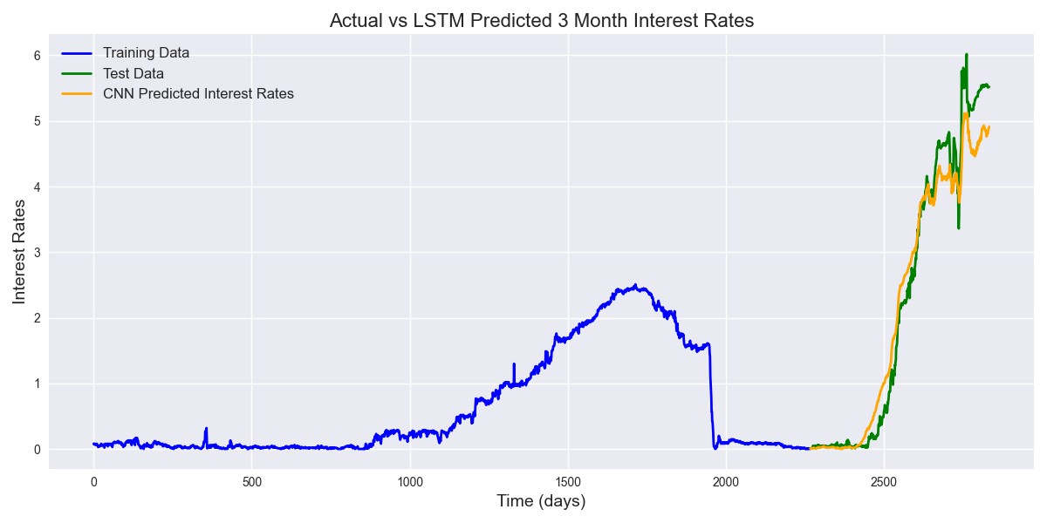
Results

Slide 11
Results
Model | MAE | MSE | RMSE
ARIMA | 0.340809 | 1.553553 | 1.246416
CNN | 0.239776 | 0.120149 | 0.346625
MLP | 0.249563 | 0.123082 | 0.350830
LSTM | 0.296354 | 0.197447 | 0.444350
ARIMA exhibits larger error in all metrics compared to other models, which may be caused by oversimplifying linearity assumption between predictors and interest rates.
CNN emerges as the top-performing model, showcasing superior accuracy in capturing the nuances of short-term interest rate fluctuations.

Slide 12
Conclusion
Our results showcased the effectiveness of the ARIMA model in capturing the dynamics of interest rates, albeit at a different scale due to differencing.
The feature importance analysis sheds light on the critical role of economic indicators, providing a nuanced understanding of their impact on interest rate forecasting.
Machine learning models, such as MLP, CNN, and LSTM, offered competitive performance, demonstrating the versatility of our approach.
However, the unique preprocessing steps of the ARIMA model, resulting in a different scale and fewer data points, may introduce challenges in direct comparisons with machine learning models.
Our research lays the groundwork for refining models through hyperparameter tuning and exploring ensemble approaches to further enhance predictive accuracy.

Slide 13
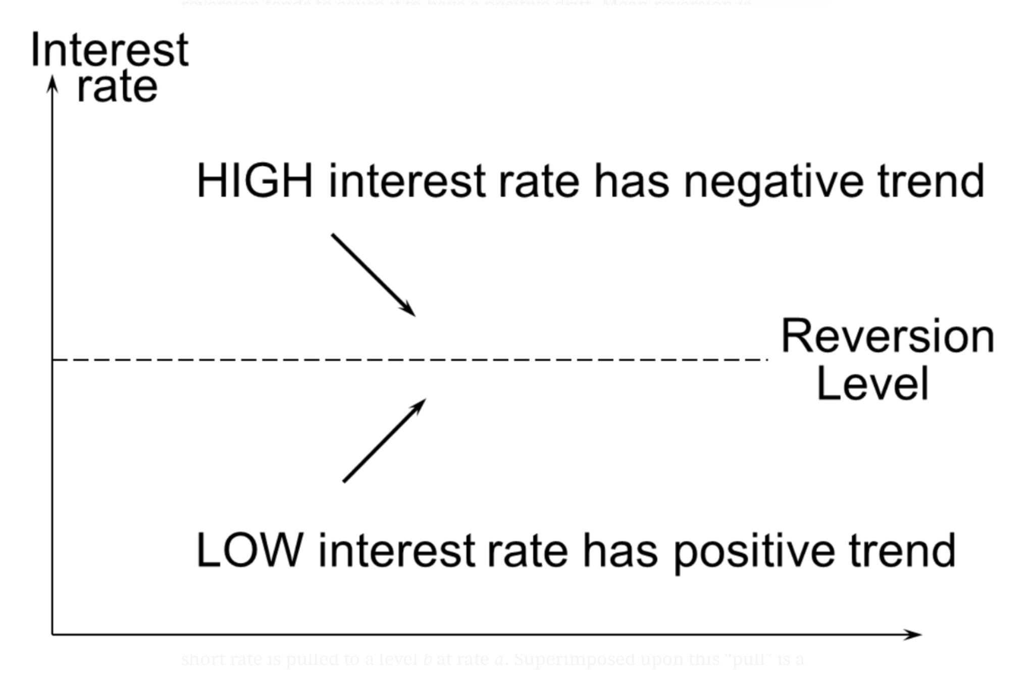
Supplementary: Vasicek Model
In Oldřich Vasicek’s (1977) model, the interest rate r = r(t) satisfies the following stochastic differential equation
dr = a(b-r)dt + σdW
where a, b, and σ are constant. This model incorporates mean reversion. One can apply the MLE to estimate Vasicek's parameters (a,b,σ) given the training dataset.

Slide 14
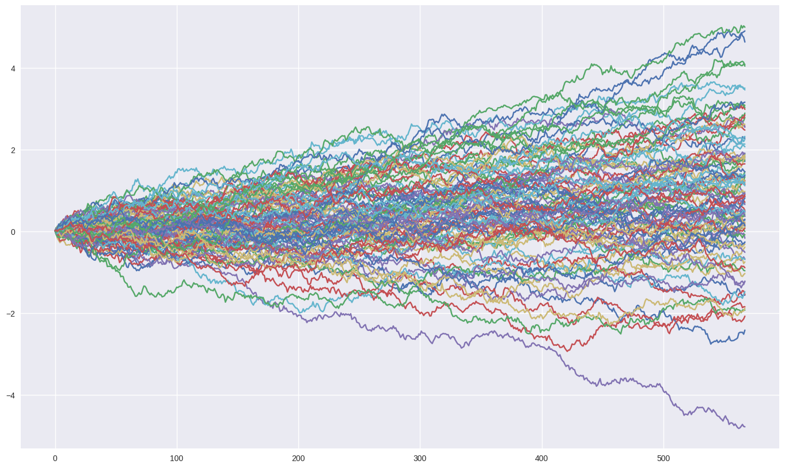
Supplementary: Vasicek Model
We estimate that the interest rate 567 days ahead is between 0.593% and 0.623%.
The average value is 0.608% as of the valuation date.
However, the true interest rate of the last day is 5.52%, which is far from the predictive range.
This suggest that the model assumption may be too simple for modeling the volatile structure of the interest rate.

Slide 15
Non-Technical Project
Nvidia Balance Sheet & Income Statement
Risk Analyst Positions and Preparations

Slide 16

Why Nvidia
Background in Science + Interest in Finance
Tech-Company
Resilience toward economic Downturns (Covid)
Possibility of Innovation
Higher Salary
Learn to evaluate the performance of tech-companies
Job hunting in finance related areas

Slide 17
Research Questions
This report is facing a stakeholder, requesting an analysis of NVIDIA's financial statements. Their interest in NVIDIA's financial health would be driven by a need to make informed decisions related to investment, creditworthiness, or work planning. Therefore we have the following research questions:
What do NVIDIA's revenue and net income trends indicate about the company's growth and profitability over time?
What is the trend in NVIDIA's R&D spending, and how does it correlate with revenue growth and product innovation?
What do liquidity ratios from the balance sheet (like current and quick ratios) reveal about NVIDIA's financial health?
How does the company's debt profile and leverage, as shown by the debt-to-equity ratio, compare to industry norms, and what does it say about financial risk?
How effectively is NVIDIA using its assets and equity to generate profits, as shown by ROA and ROE?

Slide 18
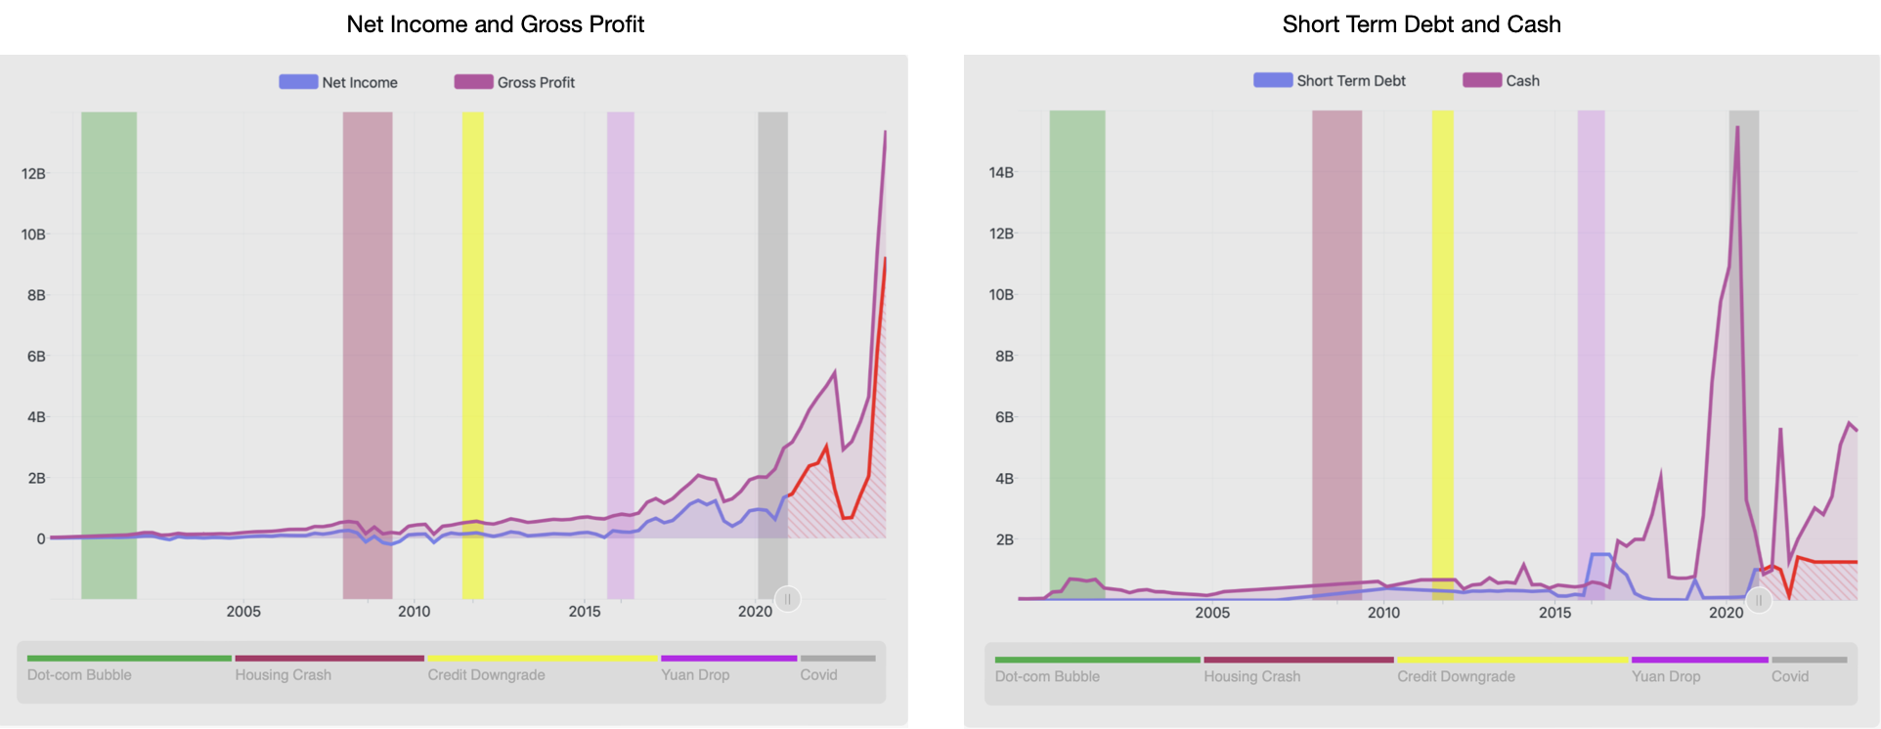
Background
the company experienced a surge in demand for its products or services during the pandemic
Nvidia is actively managing its liquidity by maintaining a cash reserve that generally exceeds its short-term debt.

Slide 19
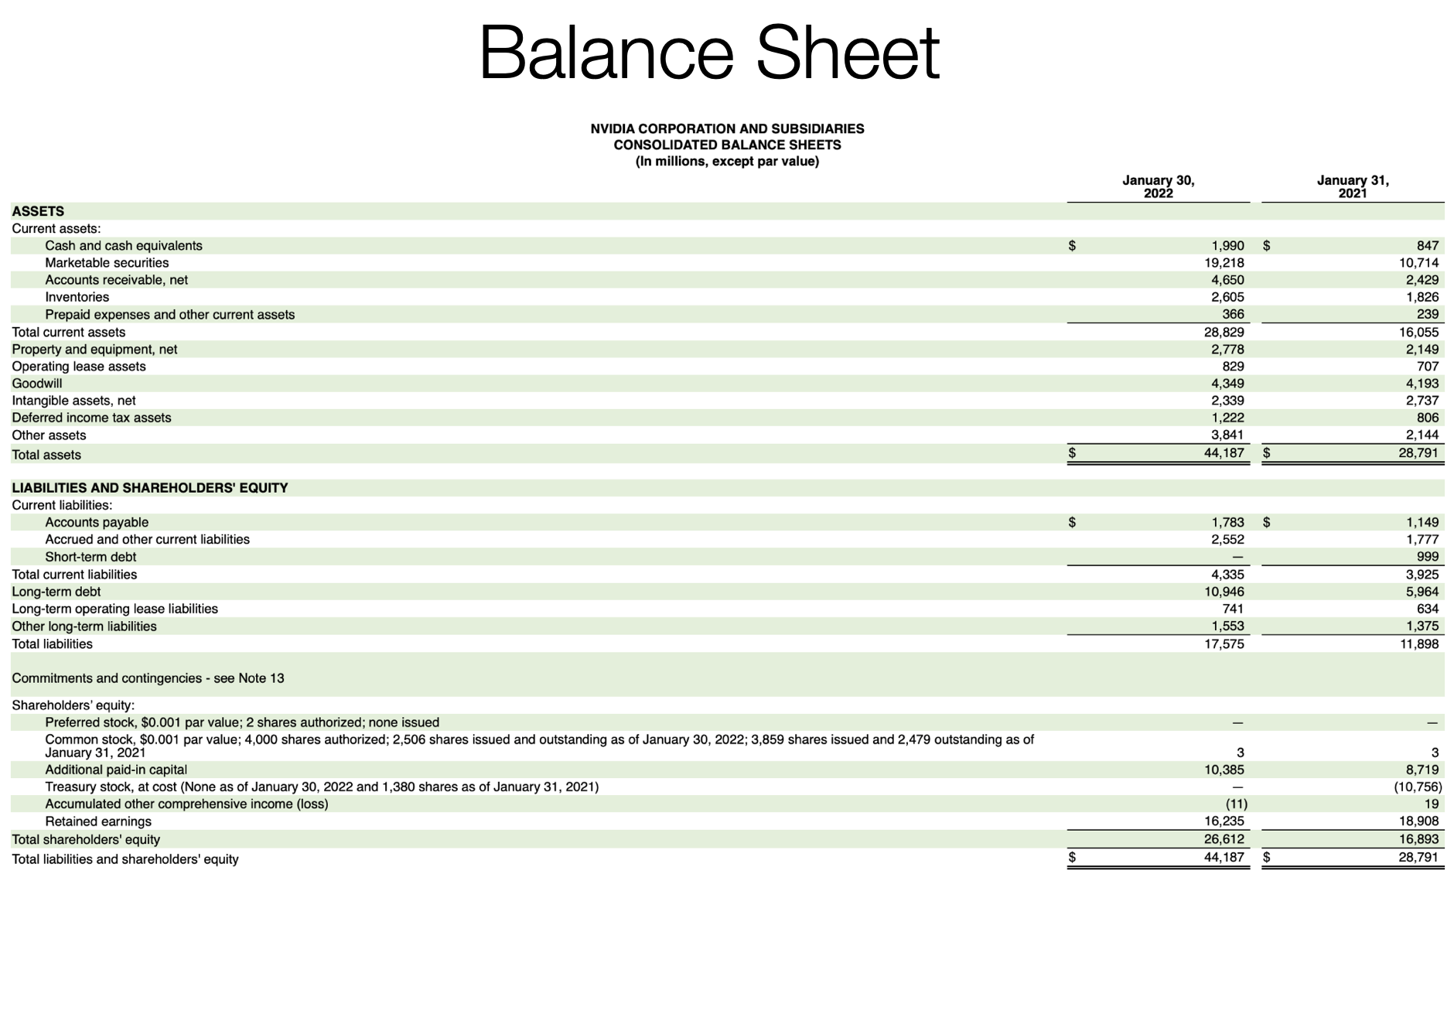

Slide 20
Important Ratios
Net Profit Margin = Net Income/Revenue = 28.829/10.946 = 2.63 This ratio indicates the percentage of revenue that translates into net income.
Return on Assets (ROA) = Net Income/Total Assets = 9.752/26.914 = 22.07% ROA measures how efficiently a company's management is using its assets to generate profit
Return on Equity (ROE) = Net Income/Shareholders Equity = 9.752/26.612 = 36.65% ROE indicates how effectively management is using shareholders' equity to create profits.

Slide 21
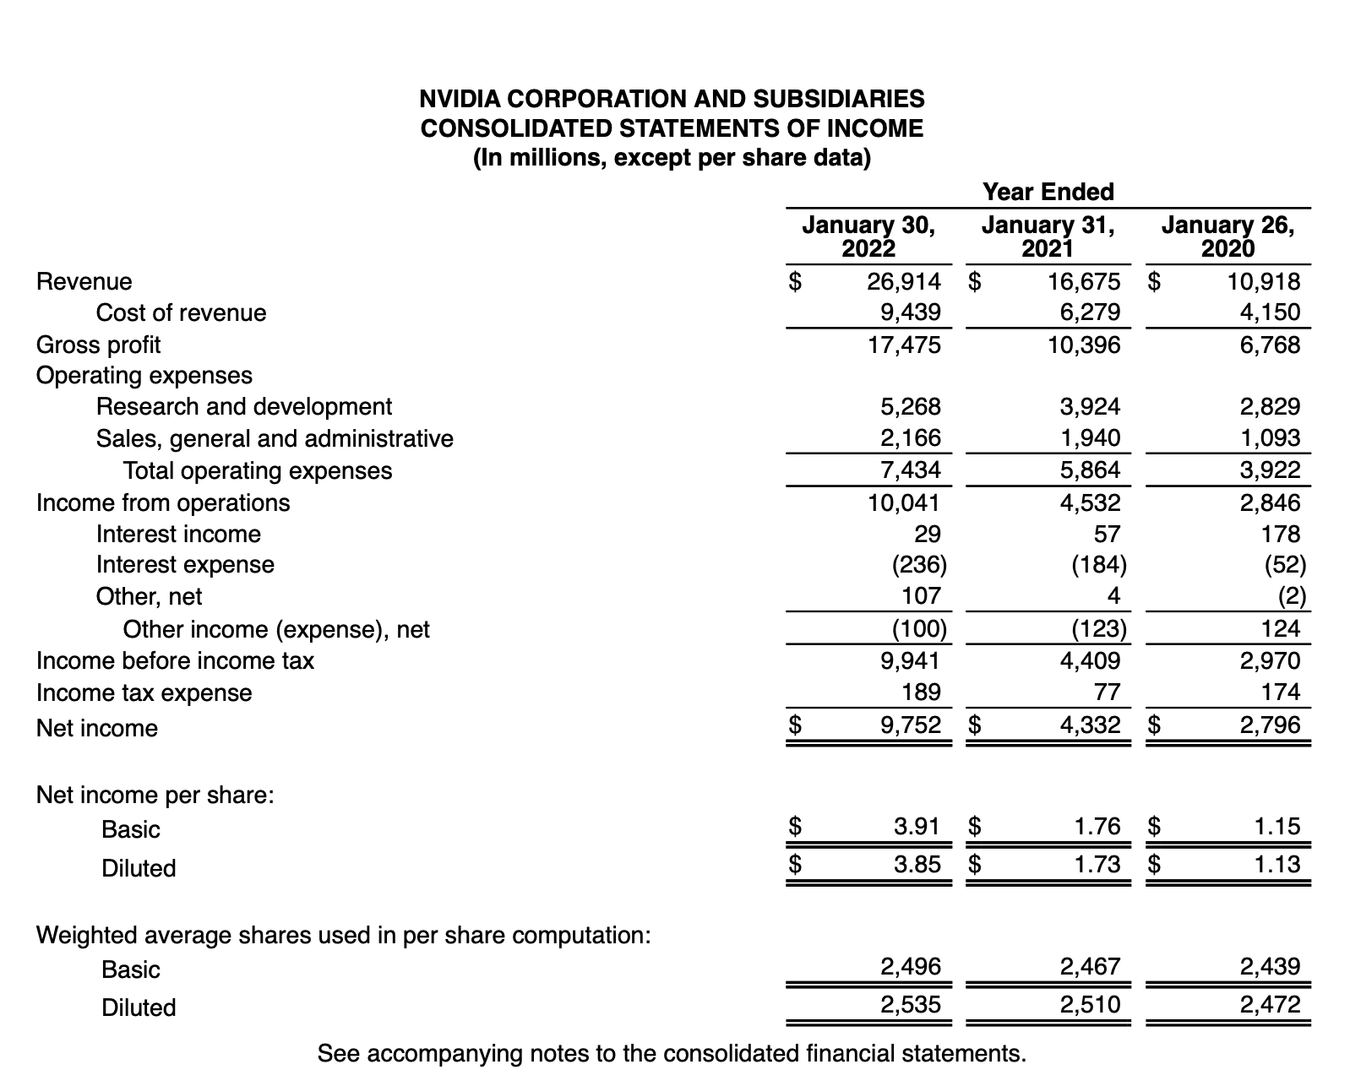

Slide 22
Important Ratios
Current Ratio = Current Assets/Current Liabilities = 28.829/10.946 = 2.63 measures a company's ability to pay short-term obligations with its current assets.
Quick Ratio = (Current Assets - Inventory) / Current Liabilities = (28.829-2.605)/10.946 = 2.40 It assesses a company's ability to meet its short-term obligations with its most liquid assets.
Debt to Equity = 10.946/26.612 = Total Liabilities / Shareholders' Equity = 0.41 Low ratio suggests NVIDIA is not overly reliant on debt to finance its operations and indicates lower financial risk compared to industry norms.
Interest Coverage Ratio = Earnings Before Interest and Taxes (EBIT) / Interest Expense = 10.041/236 = 42.55 Implies a low risk of financial distress from its current level of debt.

Slide 23
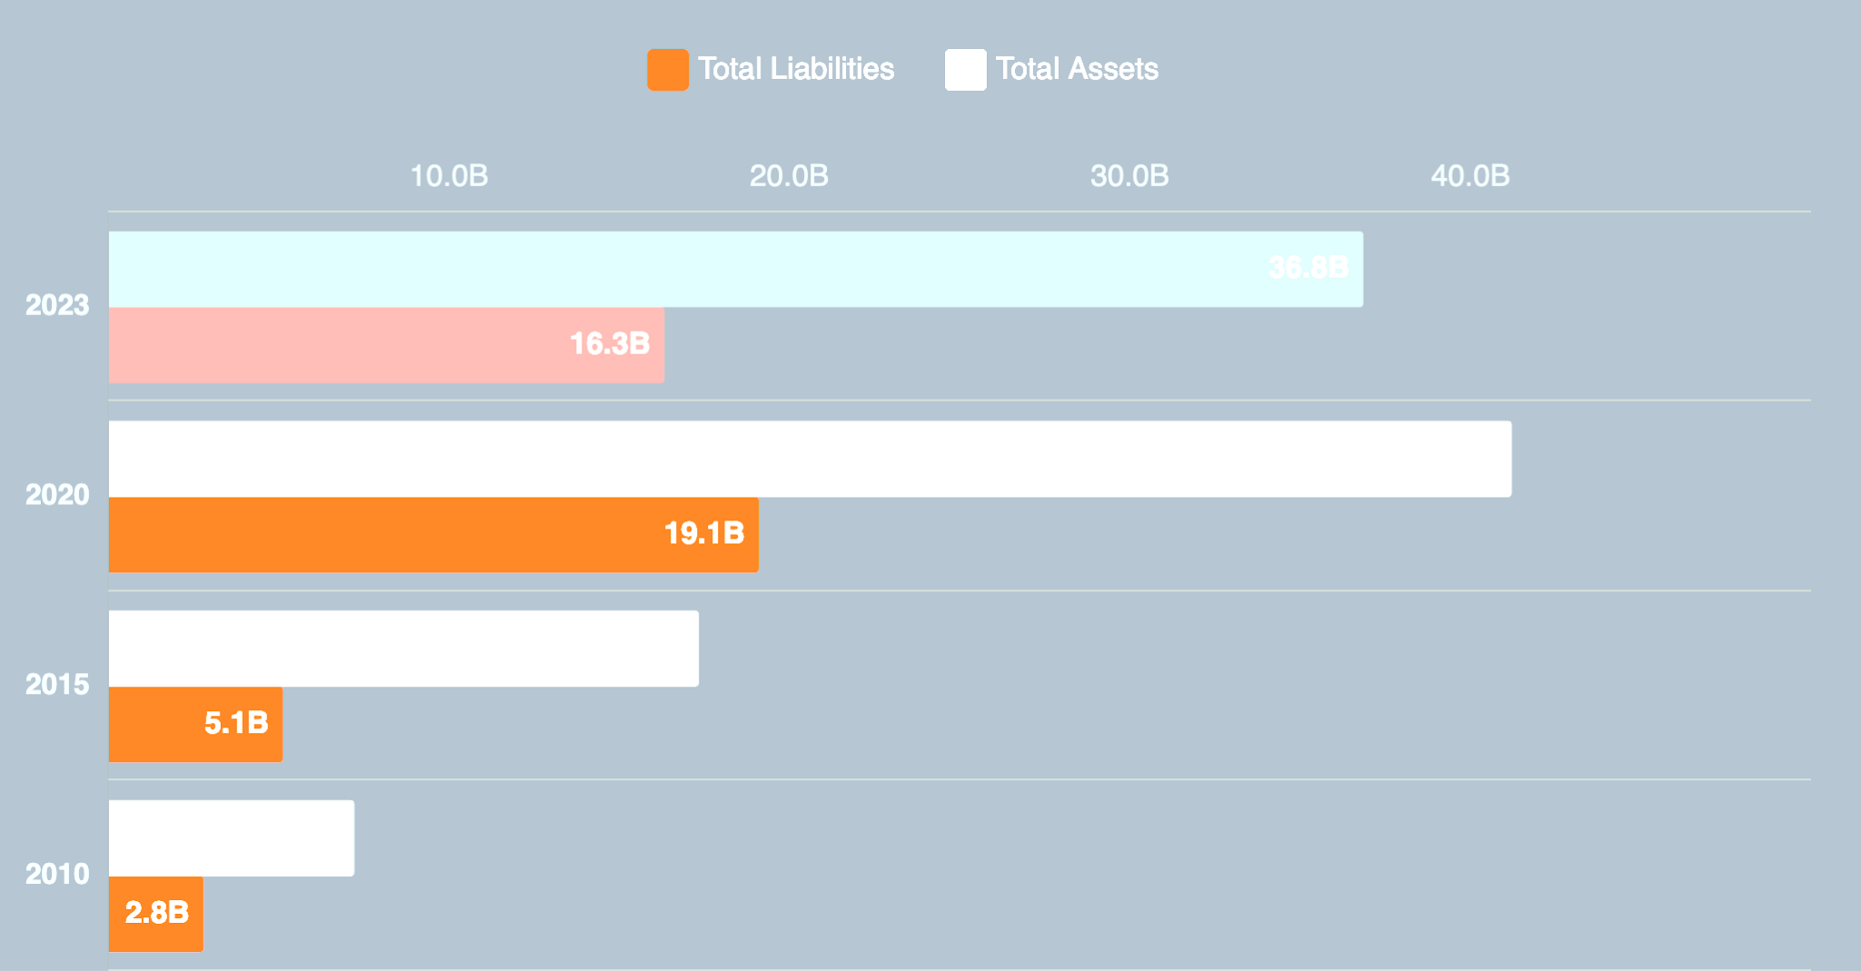
The General Trend and Projection

Slide 24
Potential Risks
1. Increased Operating Expenses
2. Growing Short-term Debt
3. Reliance on Marketable Securities for Liquidity
4. Economic and Market Conditions
5. Tax Rate Changes
6. Cybersecurity Threats
7. Supply Chain Disruptions

Slide 25
Job of Interest: Equity Analyst
Focus on a niche segment, category or country of a capital market
Not as broad of a view of finance as a Financial Analyst
Not as marketing inclined as some domains of Investment Banking
Two sides: Buy-side(financial advisory) and sell-side(investment banking)
More aligned to our science/math/engineering/economics background– fairly technical with certain data points gathered from market news, contacts or senior leadership in specific companies
Recognition: Named in certain research reports

Slide 26
Equity Analyst: Qualifications
Most basic qualification: Bachelors degree, start out in research associate positions
Master’s degree or above helps one advance their career path in this domain
License: Sometimes, a Financial Industry Regulatory Authority(FINRA) is required
Certifications of Interest:
Chartered Financial Analyst (CFA)
Financial Risk Manager (FRM)
Chartered Alternative Investment Analyst (CAIA)
Duke University has multiple resources to support one to prepare for this role! Just ask

Slide 27
Contributions of an Equity Analyst
Financial Modeling: They create and maintain financial models that project a company's future performance, which is crucial for decision-making and long-term planning.
Enhancing Investment Portfolios: Equity analysts play a vital role in selecting stocks that have the potential for growth, thereby improving the performance of investment portfolios for both individual investors and institutions
Risk Mitigation: Analysts help in identifying risks associated with investments, enabling investors and companies to make informed decisions to manage and mitigate those risks.
Strategic Decision-Making: Analysts provide valuable insights to company executives regarding business strategies, mergers and acquisitions, and investment priorities.
Investor Relations: Equity analysts serve as a bridge between companies and investors, facilitating transparent communication and building trust in the financial markets.

Slide 28
Equity Analyst: Notable People
Mario Gabelli: A prominent value investor, Gabelli worked as a securities analyst for farm equipment and auto parts conglomerate, before founding GAMCO Investors, a well-known asset management firm
Michael Milken: The influential financier, known for pioneering junk bonds in the 1980s, started as a bond analyst investing in non-investment grade bonds
Mary Meeker: A former Wall Street analyst, Meeker is now a venture capitalist known for her insights into technology trends.
Michael Burry: Michael Burry, featured in the book and movie "The Big Short," accurately predicted the housing market crash and made substantial profits. He is a notable example of an equity analyst who uncovered systemic issues and started out in value investing

Slide 29
Equity Analyst: Future Prospects
Future Positions: Senior Equity Analyst or Portfolio Manager
More in-depth knowledge of an industry with prospects into Private Equity, Asset Management
Keep updating mathematical models and finance knowledge with ceritifications and further qualifications
Innate maturity as to whether to invest in company A vs company B for buy side
Move into other spectrums of Capital Market

